Slide 1
Gaussian Copula Model of Correlated Default:
Calibrating the Copula Correlation
Neil D. Pearson
Copyright © 2010, 2013 by Neil D. Pearson. All rights reserved.
Notes:
Copyright © 2010 by Neil D. Pearson. All rights reserved.

Slide 2
Calibrating the Copula Correlation Rho
To use the Gaussian copula model [of default times], we need:
Estimates of default probabilities
An estimate of the copula correlation
For risk management purposes, it is common to use historical default probabilities (or rating agency “idealized” default probabilities) by rating category or rating modifier
Estimating the copula correlation is more problematic. Note that the model is an artificial device to create default dependence in a tractable way. Thus, it is difficult to interpret the common factor m, and difficult to think about how the default time of an obligor should be related to m
Copyright © 2010, 2013 by Neil D. Pearson. All rights reserved.
Notes:
Copyright © 2010 by Neil D. Pearson. All rights reserved.

Slide 3
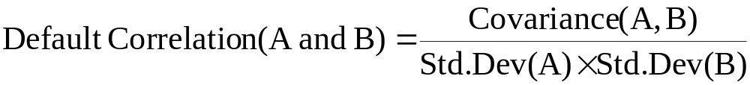
Default Correlation
Consider 2 obligors A and B. In an abuse of notation, let A and B also be r.v.’s for the default event:
A = 1 means A defaults; A = 0 means A does not default
B = 1 means B defaults; B = 0 means B does not default
One definition of the default correlation is:
Because A and B are each binomial r.v.’s, we have
Std.Dev(A) = {P(A)×[1−P(A)]}^{1/2},
and similarly for B
Copyright © 2010, 2013 by Neil D. Pearson. All rights reserved.
Notes:
Copyright © 2010 by Neil D. Pearson. All rights reserved.

Slide 4
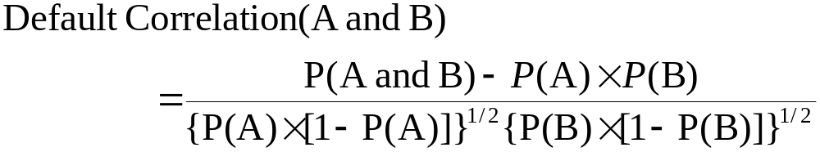
Default Correlation
We also know that
Covariance(A,B) = E[A×B] – E[A]×E[B].
In the special case of binomial random variables
E[A] = P[A] and E[B] = P[B]
and this becomes
Covariance(A,B) = P[A and B] – P[A]×P[B].
Combining this fact with the previous slide,
Remark: This default correlation is not the same as the copula correlation
Copyright © 2010, 2013 by Neil D. Pearson. All rights reserved.
Notes:
Copyright © 2010 by Neil D. Pearson. All rights reserved.

Slide 5
Default Correlation: More Than Two Obligors
An unfortunate fact is that knowing all of the pairwise default correlations does not imply that you know everything about the joint default behavior of the bonds in a portfolio. See Doug Lucas, pp. 12-17.
This is in contrast with the normal distribution, where knowledge of all of the pairwise correlations (plus the means and standard deviations) determines the joint distribution of returns
Copyright © 2010, 2013 by Neil D. Pearson. All rights reserved.
Notes:
Copyright © 2010 by Neil D. Pearson. All rights reserved.

Slide 6
Estimating Default Correlation from Data
Recall the formula
To compute default correlation of two B-rated companies over one year, we set P(A) and P(B) equal to the historic average one-year default rate for B-rated companies.
Copyright © 2010, 2013 by Neil D. Pearson. All rights reserved.
Notes:
Copyright © 2010 by Neil D. Pearson. All rights reserved.

Slide 7
Estimating Default Correlation from Data
We compute P(A and B) by first counting the number of companies rated B at the beginning of a year that subsequently defaulted over that particular year. We then calculate all possible pairs of such defaulting B-rated companies.
If X is the number of B-rated companies defaulting in a year, the number of possible pairs is
Pairs of defaulting companies = X×(X−1)/2
Examples:
X = 2 implies 2×(2−1)/2 = 1 defaulting pair (AB)
X = 3 implies 3×(3−1)/2 = 3 defaulting pairs (AB, AC, and BC)
X = 4 implies 4×(4−1)/2 = 6 defaulting pairs (AB, AC, AD, and BC, BD, CD)
Copyright © 2010, 2013 by Neil D. Pearson. All rights reserved.
Notes:
Copyright © 2010 by Neil D. Pearson. All rights reserved.

Slide 8
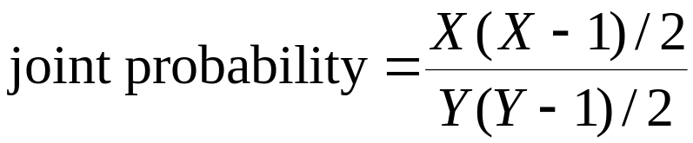
Estimating Default Correlation from Data
We next calculate all possible pairs of B-rated companies, whether or not they defaulted, using the same formula, [Y× (Y –1)]/2, where Y is the number of B-rated companies available to default.
The joint default probability of B-rated companies in a particular year is:
Calculate this statistic for each year in the sample, and average over the sample years.
Resulting average is the estimate of the joint probability P(A and B). Now we have all of the terms needed to compute the default correlation
Copyright © 2010, 2013 by Neil D. Pearson. All rights reserved.
Notes:
Copyright © 2010 by Neil D. Pearson. All rights reserved.

Slide 9
Facts About Historical Default Correlations
One can also repeat this exercise for 2-year periods, 3-year periods, 4-year periods, etc., and obtain estimates of default correlations for a period of any length
One discovers that
default correlations increase as ratings decrease; and
default correlations initially increase with time and then decrease with time
See the table on the next page, which is part of Exhibit 22 in Lucas
Copyright © 2010, 2013 by Neil D. Pearson. All rights reserved.
Notes:
Copyright © 2010 by Neil D. Pearson. All rights reserved.

Slide 10
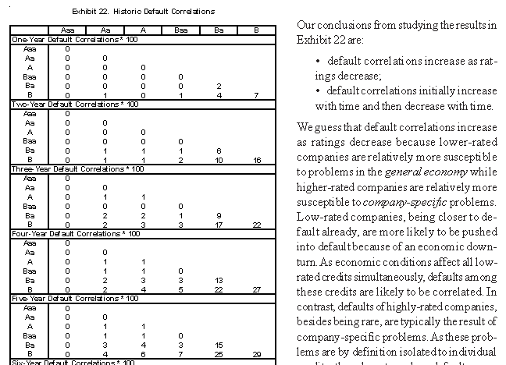
Default Correlation Estimates from Lucas
Correlation estimates are multiplied by 100, e.g. 22 means 22%
Notes:
Copyright © 2010 by Neil D. Pearson. All rights reserved.

Slide 11
Facts About Historical Default Correlations
Presumably default correlations increase as ratings decrease because lower-rated companies are relatively more susceptible to problems in the general economy while higher-rated companies are relatively more susceptible to company-specific problems.
Low-rated companies, being closer to default already, are more likely to be pushed into default because of an economic downturn. As economic conditions affect all low rated credits simultaneously, defaults among these credits are likely to be correlated.
In contrast, defaults of highly-rated companies are typically the result of company-specific problems.
Copyright © 2010, 2013 by Neil D. Pearson. All rights reserved.
Notes:
Copyright © 2010 by Neil D. Pearson. All rights reserved.

Slide 12
Facts About Historical Default Correlations
With respect to default correlation increasing and then decreasing with the time period studied, we note that default correlations peak at five and six year periods for rating pairs Baa/Ba, Baa/B, Ba/Ba, and Ba/B. However, default correlations peak at 9 years for pairs A/B and B/B.
Over arbitrarily short time periods, defaults are necessarily uncorrelated.
Imagine a database whose column headings are the names of credits and whose rows represent time intervals. Entry in a particular cell is 1 if the credit defaulted in that time interval and 0 otherwise. Ones in the same row indicate that credits defaulted together in that time interval and indicate the presence of positive default correlation. Over short period of time, no more than one 1 will appear in a row and there will be no evidence of positive default correlation
Notes:
Copyright © 2010 by Neil D. Pearson. All rights reserved.

Slide 13
Calibrating Copula Correlation to Historical Default Correlations
Default correlation defined by
is not the same concept as the copula correlation.
But the two measures are related⎯in the Gaussian copula model of correlated default times, higher copula correlation implies higher default correlation as defined above
If one has estimated the default correlation for a rating category, or for the overall universe of say all rated obligors, one can then pick the copula correlation to match the estimated default correlation.
Notes:
Copyright © 2010 by Neil D. Pearson. All rights reserved.

Slide 14
Another Approach to Calibrating the Copula Correlation
There are two reasons not to take the approach above
First, to estimate the joint default probabilities using the formula
requires that you have access to the rating agency default databases. The data summaries like on the next slide are freely available, but the full databases are not
Second, if you have a diversified portfolio, you might not care about P(A and B), but only about the variability of annual default rates
Notes:
Copyright © 2010 by Neil D. Pearson. All rights reserved.

Slide 15
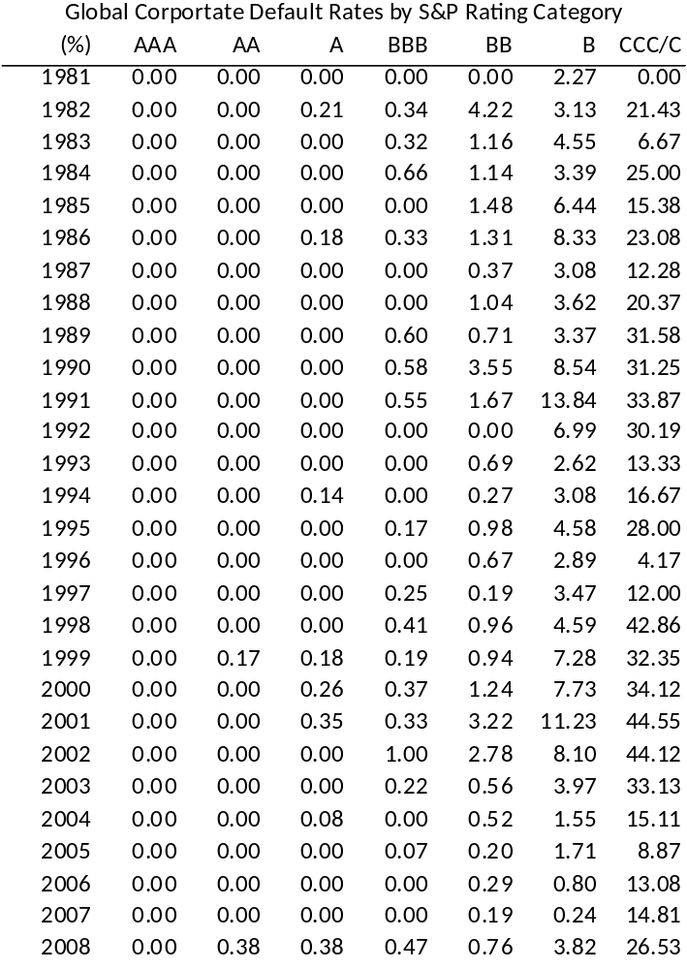
Default Rates by S&P Rating Category
Data summaries like these are freely available, but the underlying default data are not. This is not a big issue if you care only about the variability of annual default rates.
Source: Standard & Poors, Default, Transition,
and Recovery: 2008 Annual Global Corporate
Default Study And Rating Transitions, April 2, 2009,
Table 2.
Note the elevated default rates
during recession periods
Copyright © 2010, 2013 by Neil D. Pearson. All rights reserved.
Notes:
Copyright © 2010 by Neil D. Pearson. All rights reserved.

Slide 16
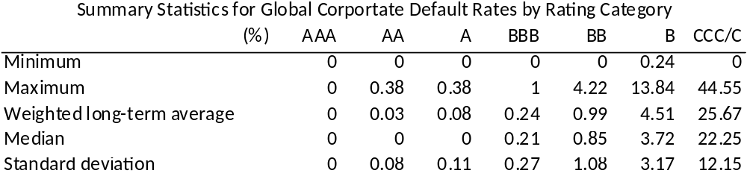
Summary Statistics for Default Rates by S&P Rating Category
Recall this table from an earlier set of slides
Rather than calibrate the model to P(A and B), you can calibrate the model to the variability of annual default rates. E.g., if your portfolio is BB, then calibrate to match the std. dev. of 1.08
Source: Standard & Poors, Default, Transition,
and Recovery: 2008 Annual Global Corporate
Default Study And Rating Transitions, April 2, 2009,
Table 3.
Copyright © 2010, 2013 by Neil D. Pearson. All rights reserved.
Notes:
Copyright © 2010 by Neil D. Pearson. All rights reserved.

Slide 17
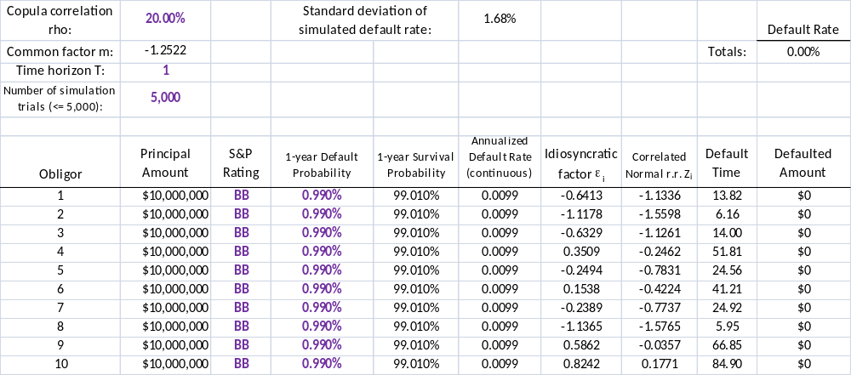
Calibrate the Copula Correlation to Match Std. Dev. of Annual Default Rates
Excel spreadsheet GaussianCopulaCalibration.xlsm illustrates this calibration
First tab (and the macro) calculates default rate
First tab (and the macro) simulate defaults given
probability and
copula correlation.
First tab also calculates annual default rates.
Copyright © 2010, 2013 by Neil D. Pearson. All rights reserved.
Notes:
Copyright © 2010 by Neil D. Pearson. All rights reserved.

Slide 18
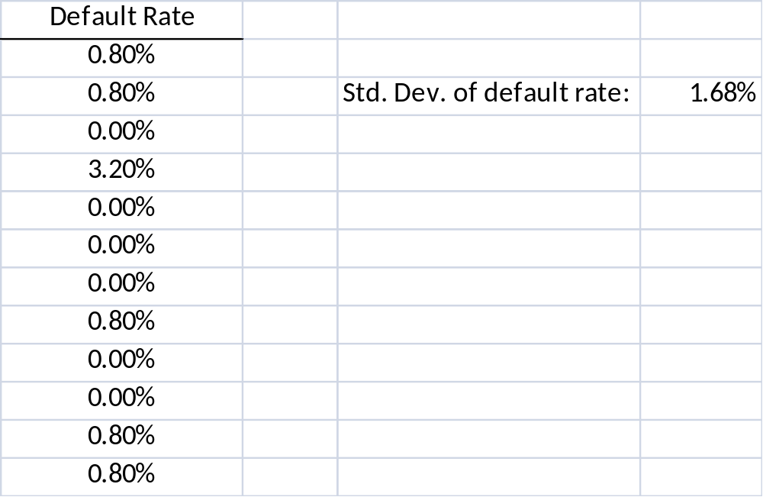
Calibrate the Correlation to Match Std. Dev. of Annual Default Rates
Macro puts simulated default rates into the tab “SimulationOutput”, and computes the standard deviation of the default rate
Then pick the copula correlation so that the standard deviation of the simulated default rates matches the data
Copyright © 2010, 2013 by Neil D. Pearson. All rights reserved.
Notes:
Copyright © 2010 by Neil D. Pearson. All rights reserved.

Slide 19
Annual Default Rates Illustrate Need to Model Default Dependence
Copied from an earlier set of slides…
The variability in the annual default rates in the previous slides illustrates the need to model default dependence
There are many rated obligors; if defaults were independent, the annual default rates would show little variability due to the law of large numbers (each year, there are a large number of obligors exposed to the risk of default)
Modeling default dependence is necessary to capture the distribution of defaults of a portfolio
Copyright © 2010, 2013 by Neil D. Pearson. All rights reserved.
Notes:
Copyright © 2010 by Neil D. Pearson. All rights reserved.

Slide 20
An Issue with Default Correlations
Recall this table, and that we interpreted it as evidence of default dependence. If default probabilities are constant each year, then it is evidence of default dependence.
An alternative approach would be to let default probabilities vary over the business cycle, and have defaulted be conditionally independent. This is related to so-called “reduced form” default intensity models.
Source: Standard & Poors, Default, Transition,
and Recovery: 2008 Annual Global Corporate
Default Study And Rating Transitions, April 2, 2009,
Table 2.
Copyright © 2010, 2013 by Neil D. Pearson. All rights reserved.
Notes:
Copyright © 2010 by Neil D. Pearson. All rights reserved.

